Slide 1
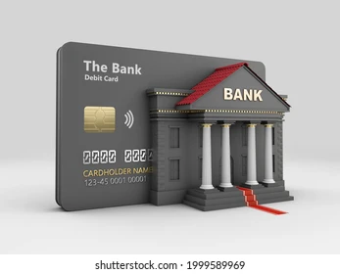
Bank Churn Predictor:
The purpose of the project is to develop a binary classifier using Logistic regression, Random Forest or deep learning model to create a predictive tool that estimates the likelihood of bank customers attrition trends.
Machine learning (ML) Project

Slide 2
The Team
Bethelhem Arefayne
Maksym Andreiko
Umeadi Dungor

Slide 3

Problem Statment
A bank managers are worried why the customers are leaving their bank and they would like to identify the patterns.
Business goals are:
Increase customer satisfaction
Decrease churn rate

Slide 4
Project Overview
Data
Overview
Dataset includes 10127 rows and 23 attributes with 7 categorical and 16 numerical variables. The data has no missing values and duplicates.
Develop model that would help a bank predict the customers who are going to get churned.
Based on the data the problem is identified as classification problem.
Dataset title: Credit Card Customers
Data source: Kaggle
Link:
https://www.kaggle.com/datasets/sakshigoyal7/credit-card-customers

Slide 5
Steps
Tools used: Python is the main technology that was used for this project. Some of the libraries that were imported were Pandas - used for data processing and plotly and matplotlib for data visualizations. Tableau was also used for additonal data visualizations.
Step 1
Step 2
Step 3
Step 4
Data Preparation
Uploaded csv file
Imported libraries
Cleaned data
EDA
Customer demographics
Data distribution
Data Process
Classify problem
select feature
Scale data
Train data
Balance data
ML Model
Select model/s
Make predictions
Evaluate
Accuracy score
Confusion matrix

Slide 6
Gender Rate
Male
47.1%
Female
52.9%
Female customers are slightly higher than the male customers.

Slide 7
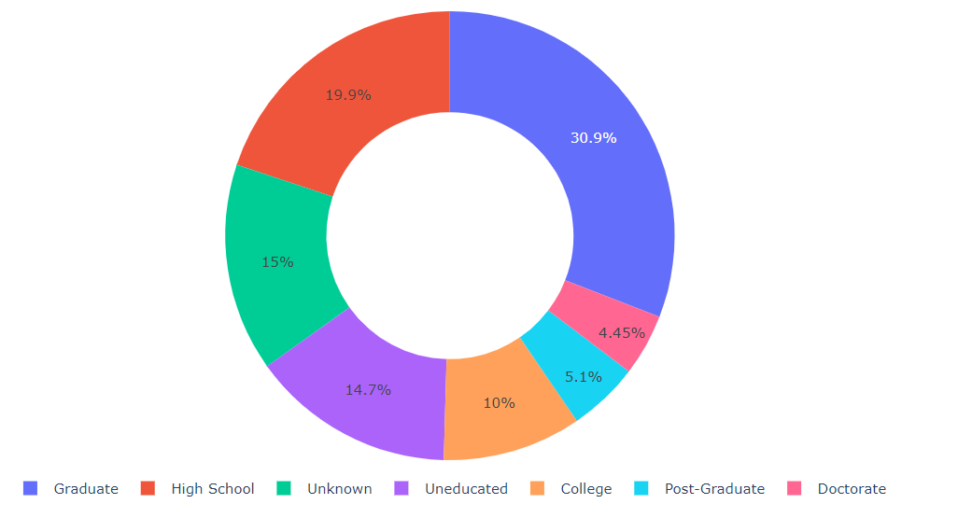
Education Level
70%
of customers are educated
15%
of customers are uneducated
View More
of customers education level is unknown
15%

Slide 8
4,000
Income Category
3,000
35%
of customers have less than 40k income
2,000
of customers unknown income
11%
1,000
View More
0
7%
of customers have more than 120k income
$40K - $60K
$60K - $80K
Unknown
$120K +
Less than 40K
$80K - $120K

Slide 9
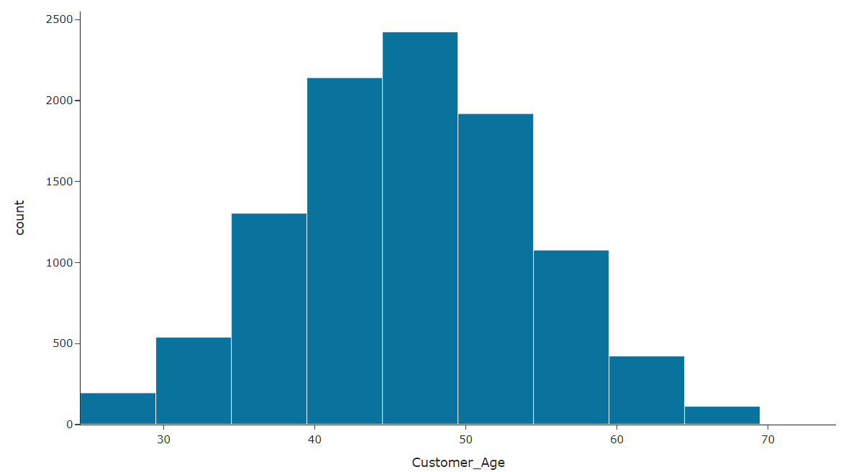
Age Distibution
Average age of the bank customers is 46.

Slide 10
Card Category
Silver
5.5%
93%
of customers have blue cards
of customers have silver cards
5%
View More
Blue
93.2%
2%
of customers have gold and platinum cards

Slide 11


Model
After data exploration, it's concluded that the churn prediction is a classification problem.
Selected Models
Logistic Regression
Random Forest
Neural Network

Slide 12
Target Variable
Attrition Flag
Attrited Customers
16.1%
Out of the 10,127 rows, 1627 customers have left the bank.
This causes an imbalanced data.
Issue: Data proportion makes prediction difficult.
Solution: Balance data using RandomOverSampler.
Existing Customers
83.9%

Slide 13
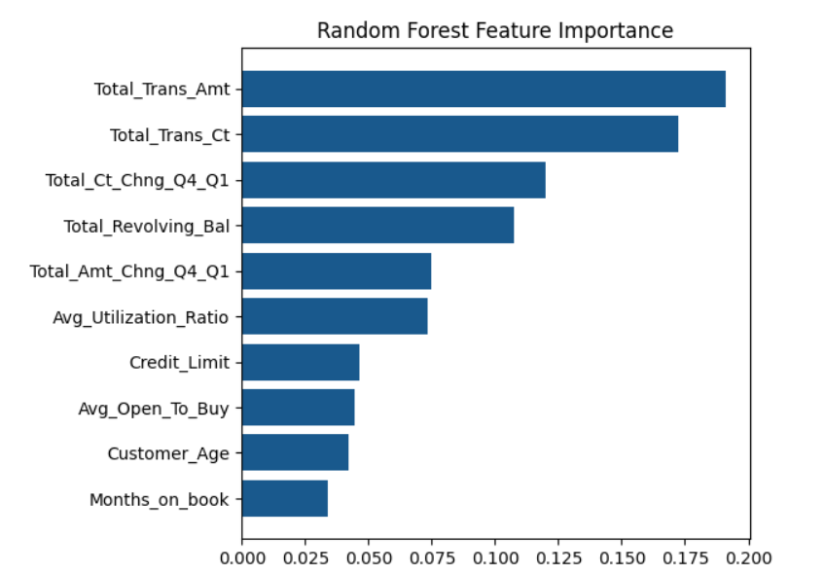
Random Forest
Feature Importance
19%
Total Transaction Amount
17%
Total Transaction Count
View More
12%
Total Count Change from Q4-Q1
Code adapted from: https://www.kaggle.com/code/andreshg/churn-prediction-0-99-auc-h2o-sklearn-smote#4.-Feature-Selection

Slide 14
Model Comparison
Classification report Before balancing data
Accuracy
Precision
Recall
f1-score
Logistic Regression Model
88%
70%
49%
57%
Random Forest Model
94%
88%
71%
79%

Slide 15
Model Comparison
Classification report After balancing data
Accuracy
Precision
Recall
f1-score
Logistic Regression Model
83%
82%
84%
83%
Random Forest Model
99%
97%
100%
99%

Slide 16
Results
Classification report After balancing data
Accuracy
Loss
Neural Network Model
93%
17%

Slide 17
Conclusion
Based on the results, it is recommended to use Random Forest Model with Resampled Training Data.
This model achieved a higher accuracy score and demonstrated consistent precision, recall, and f1-scores for both classes.
Its ability to accurately identify both existing and attrited customers is crucial for minimizing false positives and effectively mitigating potential churns. The higher recall score for Class 1 also indicates its ability to capture a larger proportion of actual churns, which is vital for identifying the customers who are likely to leave the bank.

